Slide 1
Sellswords and Spellcrafts
Luke Schnetlage
Mason Evans
Nicolas Towery

Slide 2
Content
Technology
Design - Front End
Design - Back End
Design - Database
How to Deploy
Known Bugs
Future Work

Slide 3
Technology

Slide 4
Technology Stack
Original Tech Stack
Hosting service: iFastNet
Database language: MySQL
Frontend framework: React
Backend framework: Node JS / PHP
Final Tech Stack
Domain hosting service: Replit
Database hosting service: Supabase
Database language: PostgreSQL
Frontend framework: React
Backend framework: Node JS

Slide 5
Design - Front End

Slide 6
File structure
index.html
src
App.jsx
index.jsx
Pages folder
Game.jsx
Home.jsx
Rules.jsx
game_state
Board
Board.jsx
Circle.jsx
River.jsx
Slot.jsx
Active.jsx
Post.jsx
Pre.jsx
socket
socket.js
static_content
Nav_logo
Footer.jsx
Navbar.jsx
styles
cards
[cardid].png
Fonts.css
Main.css
Navbar.css
Rules.css
App.css

Slide 7
Design - Back End

Slide 8
File structure
Server
Server.cjs
pregame_actions
game_creation.cjs
pregame.cjs
game_actions
board_functions.cjs
hand_functions.cjs
info_functions.cjs
Turn_functions.cjs

Slide 9
Server.cjs
Primary connection between the front-end and back-end
Listens for the following socket emits
List_available_users
Create_game
Join_game
Deck_selected
Get_game
Place_minion
Attack_zone
End_turn

Slide 10
game_creation.cjs
Governs creation of games and the objects required for games
creategame
createcontestedzone
getdecklist
shuffle
populatecards_in_deck
createboard

Slide 11
board_functions.cjs
Governs the logic for placing and attacking with minions alongside the effects and costs for doing so
attackplayer
attackzone
damageminion
placeminion
placeterrain
payenergy
damageplayer

Slide 12
Design - Database

Slide 13
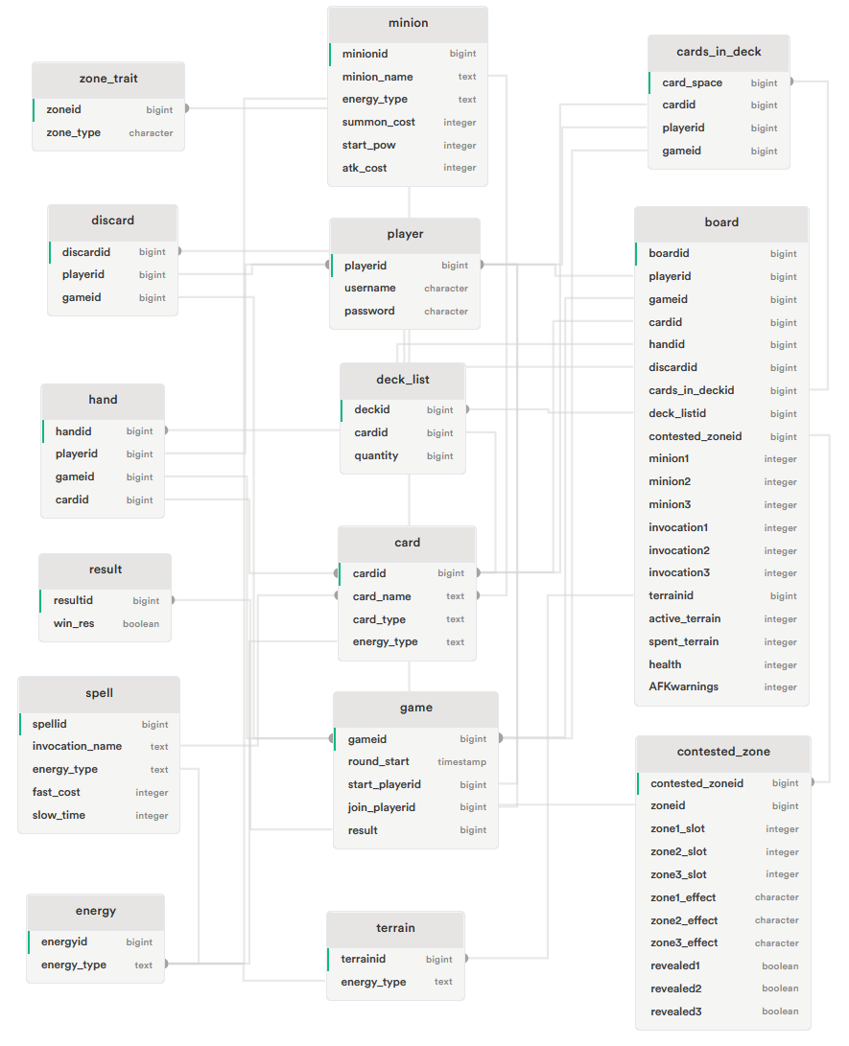
Database
Supabase database in PostgreSQL:
15 tables:
player, result, game, energy, card, minion, spell, terrain, deck_list, hand, cards_in_deck, discard, zone_traits, contested_zone, and board

Slide 14
How to Deploy

Slide 15
How to Deploy
Dependencies to install:
react, react-dom, socket.io-client, react-router-dom, @supabase/supabase-js, express, cors, body-parser, http, and socket.io
Server commands:
node server/server.cjs
Build application for deployment:
npm run build

Slide 16
Known Bugs

Slide 17
Known Bugs
Ghost Login
Users Challenging Themselves
Attacking an Occupied Minion Slot
Refresh Bugs

Slide 18
Future Work

Slide 19
Future Goals
implementing the attack player function
developing the ability to place invocations and active invocations
developing card art for all invocations
implementing the effects of specific minions and invocations
fixing inconsistent function and variable naming syntax
adding complexity to minion combat such as limiting attacks based on proximity
adding hidden effects to zones once occupied by a minion
developing a mobile app

Slide 20
Thank You

